Slide 1
Persistent Postural Perceptual Dizziness
PPPD
Translating the current neuroscience literature regarding
brain based benign balance disorders.

Slide 2
Persistent Postural Perceptual Dizziness
This power point presentation is designed to give patients an understanding of the journey balance disorder researchers/clinicians have been through over the past 30 years in trying to understand the difficulties faced by the dizzy patient.

Slide 3
Persistent Postural Perceptual Dizziness
PPPD
It has been a long journey in the scientific literature to arrive at this diagnostic point
PPPD to be included in ICD-11-2018
Benign non specific dizziness was always been seen as a primary non organic psychiatric disorder, to be treated by psychiatrists.
Psychogenic Dizziness was the most common term until Thomas Brandt suggested that such a label should be examined more closely

Slide 4
1995-96
Phobic Postural Vertigo
(PPV)
Huppert D, Brandt T, Dieterich M, Strupp M.
Phobic vertigo. The second most common diagnosis in specialized ambulatory care for vertigo].
Nervenarzt. 1994 Jun;65(6):421-3.

Slide 5
Brandt and colleagues recommended a re-examination of the physical symptoms of psychogenic vertigo and further research connections between anxiety and dizziness

Slide 6
This spawned an exciting period of ”central” vestibular research, resulting in vague balance symptoms being recognised as secondary to psychiatric illness, but acknowledging a connection

Slide 7
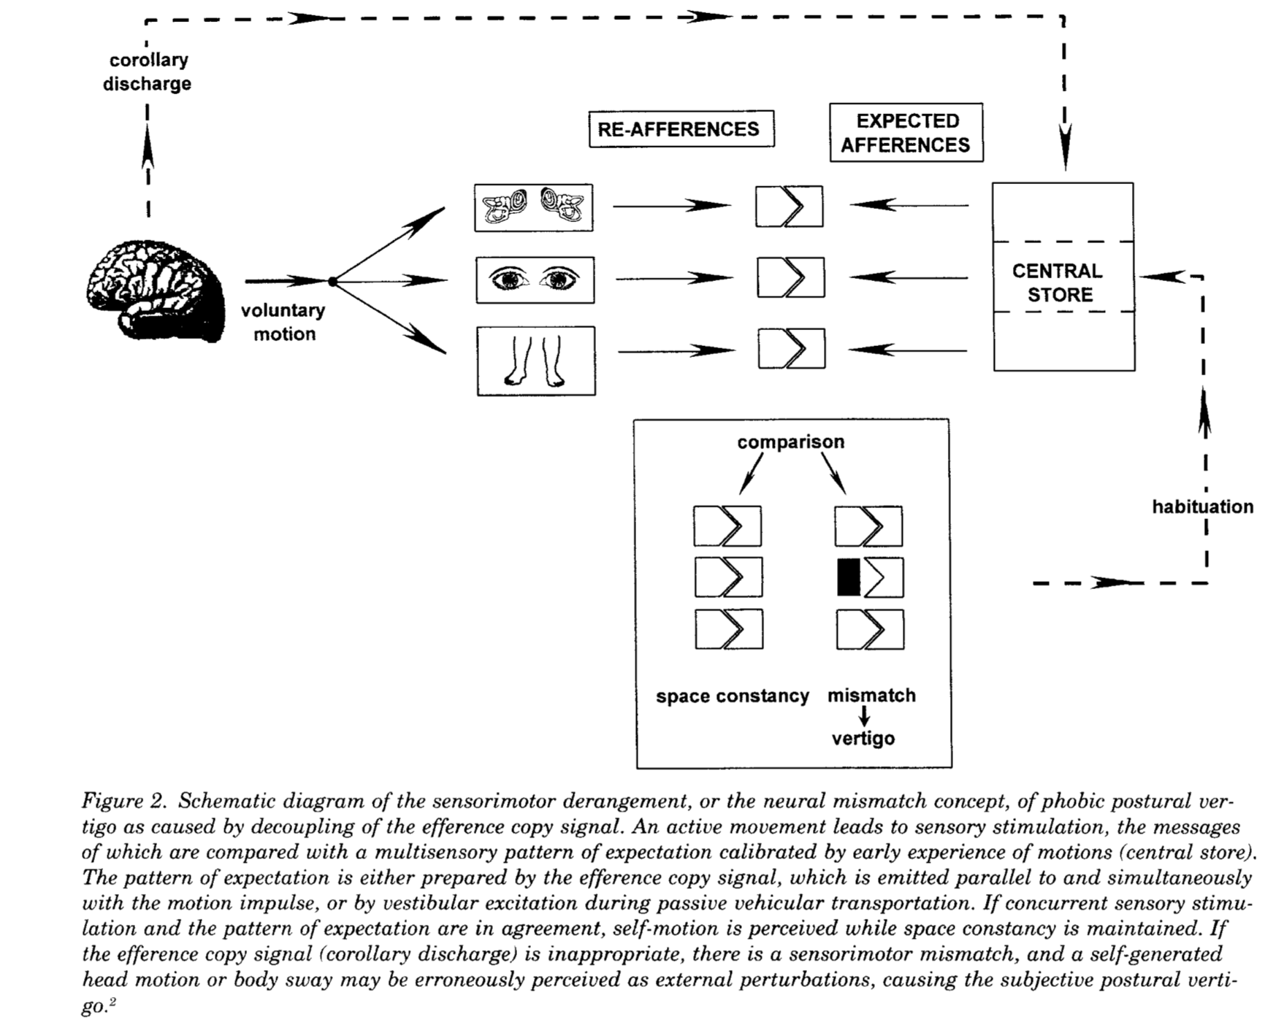
Brandt presented the following model in 1995
Brandt T. Phobic postural vertigo. Neurology 1996;46(6):1515Y1519.

Slide 8
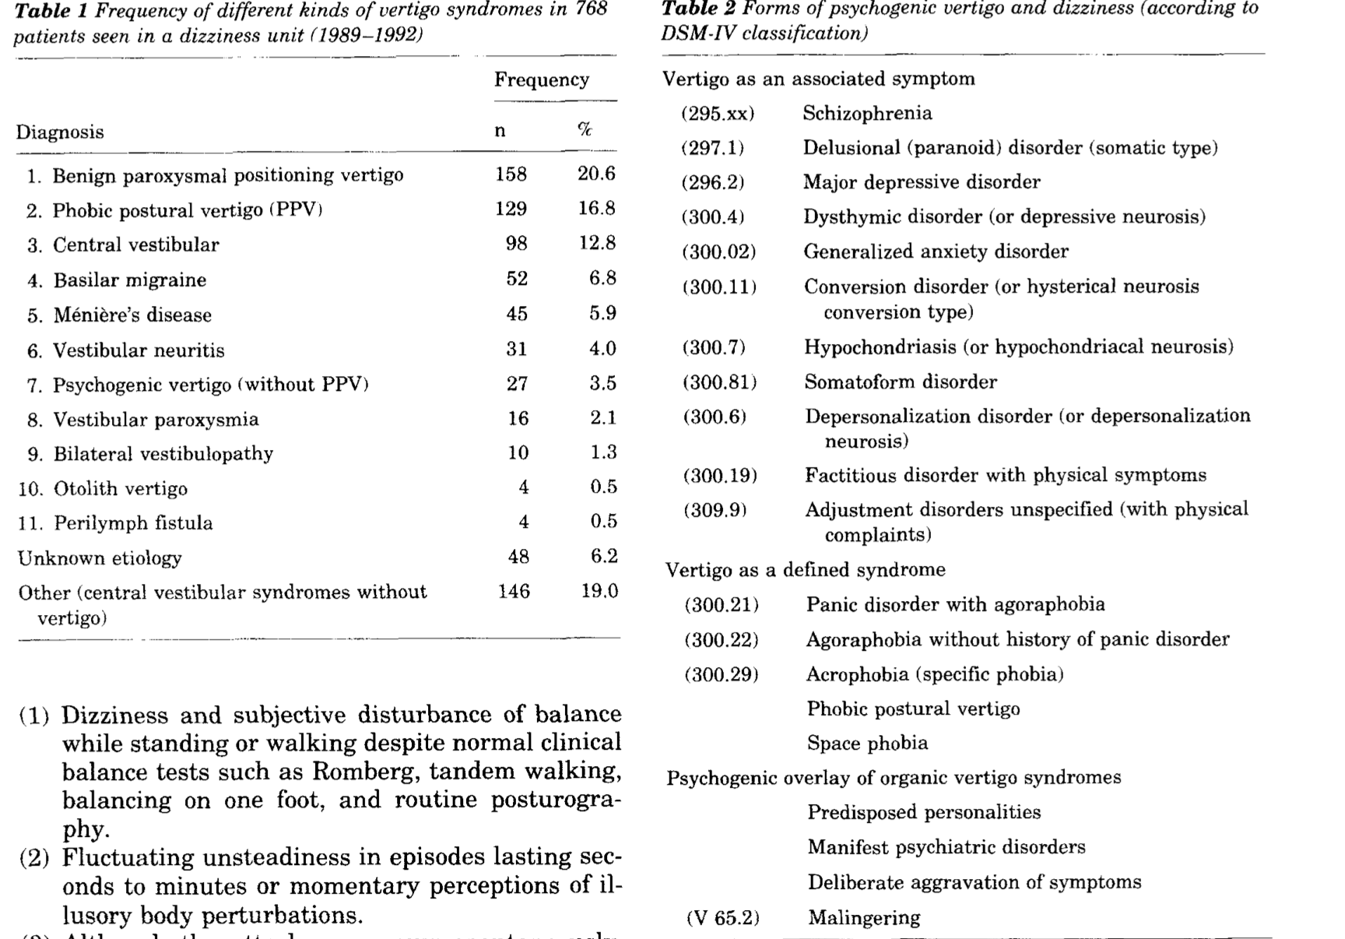
Some Descriptive Stats-1996-Brandt

Slide 9
2005
Staab introduced the term
Chronic Subjective Dizziness
(CSD) within his research

Slide 10
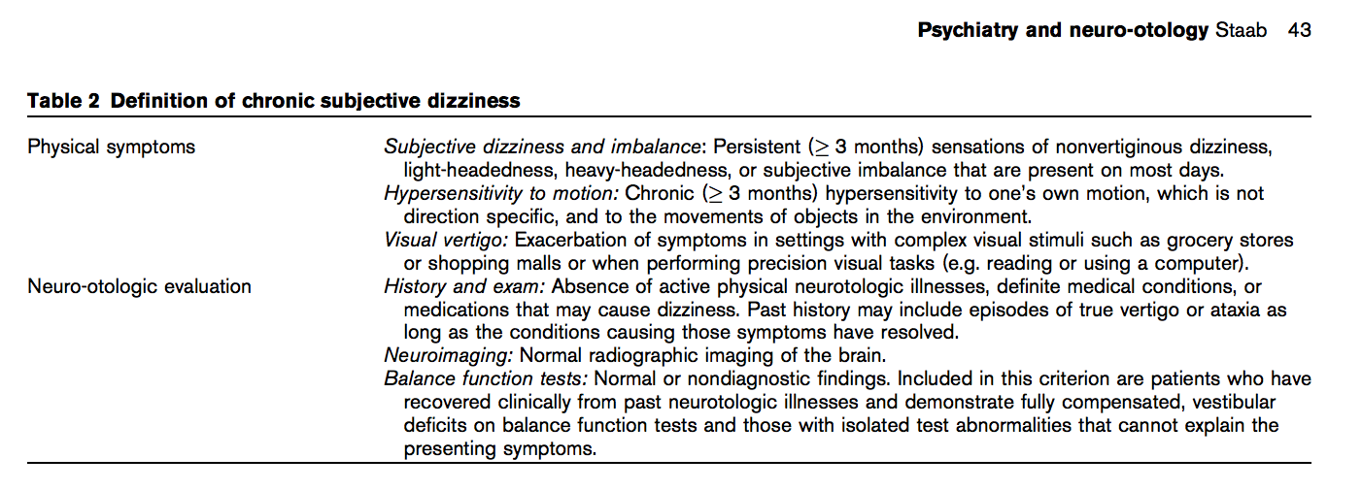
Chronic Subjective Dizziness (CSD) as an anxiety disorder
Jeffrey Staab et al

Slide 11
Persistent
Postural-
Perceptual
Dizziness

Slide 12
Persistent
Postural-
Perceptual
Dizziness
To be included in the next edition of the International Classification of Diseases (ICD) version 11 in 2018
This is a distillation of tireless work by many vestibular and brain scientists over many years.
This is excellent news for patients who have been told they have a primary psychiatric or psychological problem underlying their dizziness
This is excellent news for chiropractors and other manual therapists who have been dealing with this condition for many years but have been told they have been treating unnecessarily or their success has been co-incidental

Slide 13
Persistent
Postural-
Perceptual
Dizziness
This is excellent news for researchers and therapists who have been working within clinical neuroscience to develop brain-body strategies to improve outcomes in these patients

Slide 14
Persistent
Postural-
Perceptual
Dizziness
PPPD manifests with one or more symptoms of dizziness, postural unsteadiness, or non‐spinning vertigo that are present on most days for three months or more.
NOTE: Many patients may be experiencing this condition, but may present with a decompensating musculo-skeletal condition as their chief complaint (back pain, neck pain, headaches etc.)

Slide 15
PPPD
What does this mean for you?
Many patients experience benign ”dizziness” brought on by movement in their environment, self movement which is worse when they are standing or walking.

Slide 16
PPPD
What does this mean for you?
PPPD provides an “official” diagnosis of a condition that might prove amenable to many types of care

Slide 17
PPPD
Are we taking the time to explore the diagnosis through the patient’s history?

Slide 18
PPPD
Are we sometimes inadvertently “fixing” the condition without knowing it?

Slide 19
PPPD
Emerging objective evidence of poor postural control

Slide 20
PPPD
Hypothetical Jump
Poor Postural Autonomic Control

Slide 21
PPPD
Diagnostic Criteria
CHECK LIST
A. HISTORY OF SYMPTOMS
B. PROVOCATIVE FACTORS
C. PRECIPITATING FACTORS
D. FUNCTIONAL IMPAIRMENT
E. DIFFERENTIAL DIAGNOSIS

Slide 22
PPPD
Diagnostic Criteria
CHECK LIST
A. HISTORY OF SYMPTOMS
  One or more symptoms of dizziness, unsteadiness, or non‐spinning vertigo are present on most days for 3 months or more.
  Symptoms are persistent, but wax and wane.
  Symptoms tend to increase as the day progresses, but may not be active throughout the entire day.
  Momentary flares may occur spontaneously or with sudden movements.

Slide 23
PPPD
Diagnostic Criteria
CHECK LIST
B. PROVOCATIVE FACTORS
  Symptoms are present without specific provocation, but are exacerbated by:
  Upright posture,
  Active or passive motion without regard to direction or position, and
  Exposure to moving visual stimuli or complex visual patterns, although these three factors may not be equally provocative.

Slide 24
PPPD
Diagnostic Criteria
CHECK LIST
C. PRECIPITATING FACTORS
The disorder usually begins shortly after an event that causes acute vestibular symptoms or problems with balance, though less commonly, it develops slowly.
  1. Precipitating events include acute, episodic, or chronic vestibular syndromes, other neurologic or medical illnesses, and psychological distress.
  When triggered by an acute or episodic precipitant, symptoms typically settle into the pattern of criterion A as the precipitant resolves, but may occur intermittently at first, and then consolidate into a persistent course.
  When triggered by a chronic precipitant, symptoms may develop slowly and worsen gradually.

Slide 25
PPPD
Diagnostic Criteria
CHECK LIST
D. FUNCTIONAL IMPAIRMENT
  Symptoms cause significant distress or functional impairment.

Slide 26
PPPD
Diagnostic Criteria
CHECK LIST
E. DIFFERENTIAL DIAGNOSIS
  Symptoms are not better attributed to another disease or disorder.

Slide 27
PPPD
Treatment
There are a number of factors in the history of a balance patient that point to PPPD.
A PPPD questionnaire has been developed. It has been found to be sensitive to PPPD sufferers.
It is called the Niigata PPPD Questionnaire

Slide 28
PPPD
Treatment
There are a number of factors in the history of a balance patient that point to PPPD.
A PPPD questionnaire has been developed. It has been found to be sensitive to PPPD sufferers.
It is called the Niigata PPPD Questionnaire

Slide 29
PPPD
Treatment
Vestibular Rehabilitation combined with Cognitive Behavioural Therapy has been found to significantly assist PPPD patients

Slide 30
PPPD
Treatment
At Small Street Clinic, we have found a combination of in office and home based vestibular rehabilitation therapy over a 12 week period has provided encouraging results
Our patients achieve the ability to manage their dizziness, reducing symptoms and increasing function and engagement in activities of daily living

Slide 31
PPPD
Treatment
At Small Street Clinic, we have found a combination of in office and home based vestibular rehabilitation therapy over a 12 week period has provided encouraging results
Our patients achieve the ability to manage their dizziness, reducing symptoms and increasing function and engagement in activities of daily living

